Slide 1
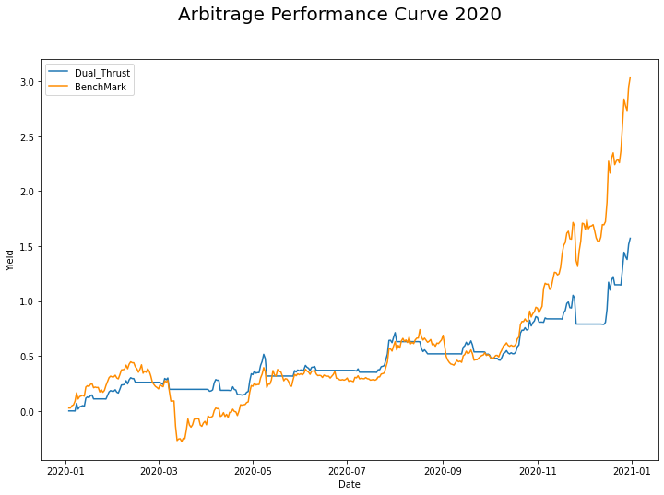
CTA strategy: Track Record
Month | Gain/ Loss (ΔNAV) | Vs BTC | Max Draw down | Tran saction No. | Correct Prediction %
Jan 2020 | 17.9% | 30.9% | 4.8% | 1 | 100%
Feb 2020 | 26.0% | 21.3% | 3.2% | 1 | 100%
Mar 2020 | 19.6% | -9.5% | 7.9% | 1 | 0%
Apr 2020 | 33.8% | 23.1% | 11.0% | 2 | 0%
May 2020 | 36.4% | 33.0% | 13.1% | 1 | 100%
Jun 2020 | 36.9% | 28.6% | 3.3% | 1 | 100%
Jul 2020 | 67.0% | 59.1% | 2.3% | 1 | 0%
Aug 2020 | 51.9% | 64.6% | 11.3% | 2 | 50%
Sep 2020 | 51.7% | 51.1% | 7.8% | 1 | 100%
Oct 2020 | 85.8% | 94.3% | 3.1% | 2 | 0%
Nov 2020 | 79.0% | 170.8% | 12.8% | 3 | 66.7%
Dec 2020 | 157.0% | 303.6% | 3.4% | 1 | 100%
2020 Performance | Arbitrage | vs BTC
Yearly rate of return | 157.0% | 303.6%
Max Drawdown | 14.7% | 50.1%
Sharpe Ratio 2019 | 1.48 | 0.86

